Slide 1

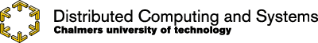
Lab 1
A First Distributed Blackboard

Slide 2
Distributed Blackboard
Develop a program that runs on several machines
Clients post to any server using a web browser
Store all received data
Propagate the newly received data
to all the other boards
in a peer-to-peer manner

Slide 3
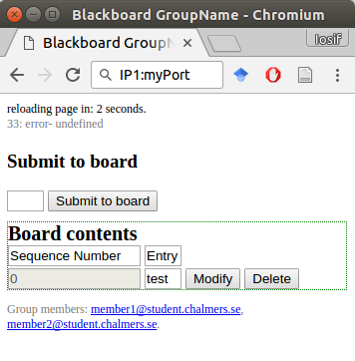
How it will look like
A blackboard looks like this
A form to submit text
Some blackboard entries
Options for each entry

Slide 4
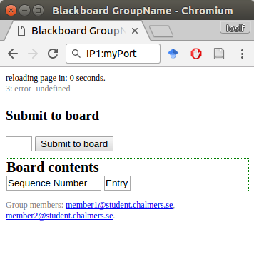
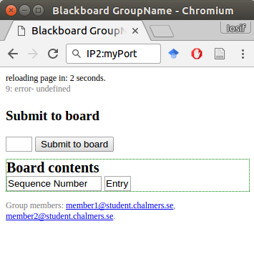
A small example
Initially: empty blackboard on all vessels

Slide 5
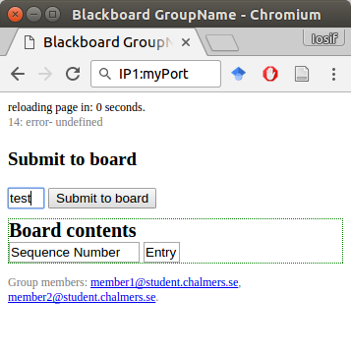
A small example
On vessel 1:
Write text and submit
On vessel 2:
No action on the browser

Slide 6
A small example
On vessel 1:
Text appears on the board
On vessel 2:
No action on the browser

Slide 7
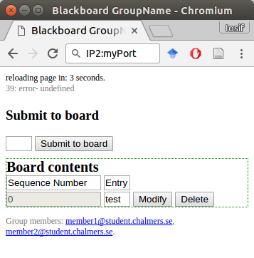
A small example
On vessel 1:
No action on the browser
On vessel 2:
Hit refresh and see post!

Slide 8
A small example
A user should also be able to modify and a delete each post.

Slide 9
Communications between a client and any server
HTTP requests
GET / -> display the page
GET /board -> display the content of the board (the data)
POST /board -> add a new value to the board
HTTP Status
We can inform the client upon a request
200: OK
400: Bad Request (But this should never happen!)

Slide 10
Another way to view it
3. POST /propagate
4. 200: OK
1. POST /board
3. POST /propagate
2. 200: OK
4. 200: OK
You’ll test on more servers, but the principle stays the same!

Slide 11
Some hints to help you
Keep a list of all vessels in each vessel
(We know, this is not a scalable design, you will work on this aspect in the following labs)
Upon a post
Send the update to all other vessels
But don’t wait for the other to reply before responding to the client!
Store the value, it should be shown at the next refresh

Slide 12
Some hints to help you (2)
HTTP formatting
We do not care how it looks as long it is usable
Don’t lose too much time on formatting, ‘hello world’ and ‘hello+world’ are both valid entries
The mininet script we are giving you directly calls a python script called server/server.py
You should implement your code there
The script also provides the server IP as input to the script, if you want it (and you should)

Slide 13
What we give you
A sample HTML file
Change it if you want (totally optional)
A skeleton Python file
A very simple HTTP server
A Mininet script
Everything is ready, run it with sudo python lab1.py
Answers to your questions in the labs
Demo slots

Slide 14
What you will give us
Your code
Well structured
Well documented
For EACH task
A video or a report for each task
In total, 3 videos or 3 reports!
Unit tests
A way to test your code easily through a script

Slide 15
Surprise!
You do not need to write a report for the tasks
But you need to submit a video / screencast
either a report or a video
Do not spend time to make it look and sound great Good is enough.
Aim for 2-3 minutes per task
Do not waste time trying to fit in. (5 minutes is okay too).
The goal is to have n fun and efficient alternative to a report

Slide 16
Hints for videos
We want something useful that
shows a demo
explain the algorithm
explain how the interesting parts of the code work
answer the questions we pose in the tasks
Software hints:
screenomatic
you can borrow a microphone
you can use your mobile phone if your PC does not like screencast.

Slide 17
Lab tasks
The important stuff

Slide 18
Task 1: make it work
Demonstrate that your distributed blackboard by submitting a 1-2 minutes video (or report)
Use at least 8 vessels/blackboards
Do 3 posts and show them on the other blackboards
Hint: show the browser windows and (optionally consoles) next to each other on your screen
Record your screen and document what is happening by using your mouse and your voice
No video editing, cutting, etc. required
Do not waste your time

Slide 19
Task 2: Modify and Delete values
A user must be able to delete or modify a post
See the code provided
Once a post is either modified or deleted, a vessel should propagate this change to other vessels
Submit a 1-2 minutes video/report that demonstrates this functionality

Slide 20
Task 3: Is our system consistent?
Can it happen that two vessels show different blackboards? Why?
Even when all data was reliably send to all vessels, and then we hit refresh afterwards
Hint: Use a script to do “concurrent posts” to your blackboards! (use the curl command)
Submit 1-2 minutes video or a report
Explaining your thoughts
If you can make it happen: document it in your video or report

